Slide 1
IS Covid-19 Dashboard
Using R to save our time and our sanity
The ‘go to’ organisation for Local Government improvement in Scotland

Slide 2
Outline
Who we are
The dashboard and its many challenges
How we used R to help
The ‘go to’ organisation for Local Government improvement in Scotland

Slide 3
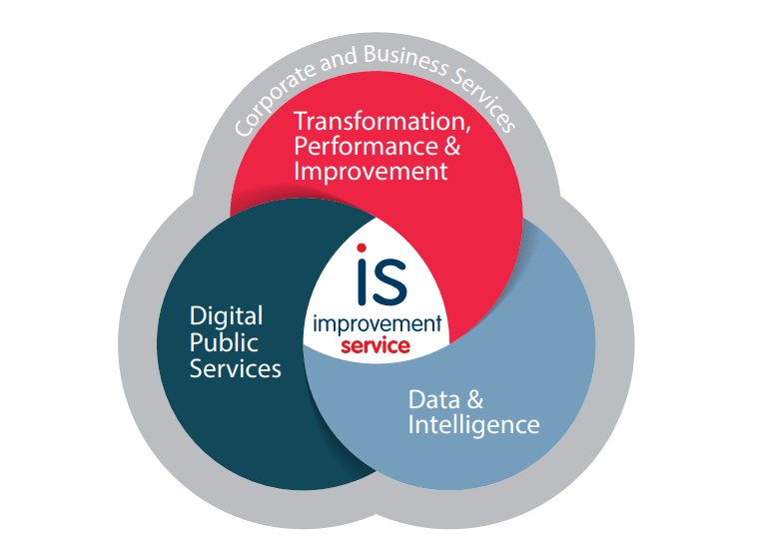

Who we are
The ‘come to’ organisation for local government improvement in Scotland
Notes:
The Improvement Service (IS) is the ‘go-to’ organisation for Local Government improvement in Scotland. national improvement body for local government -work with la and COSLA, PHS, SG
3 teams with different functions – DPS includes MyAccount, NEC and ParentsPortal, TPI includes e.g. economic development, child poverty, planning, and money/welfare advice services, transformation support
D&I team – spatial data, LGBF research and evaluation
R users – a small number – Python users in D&I team
Have been using R for a while and work a lot with Shiny

Slide 4
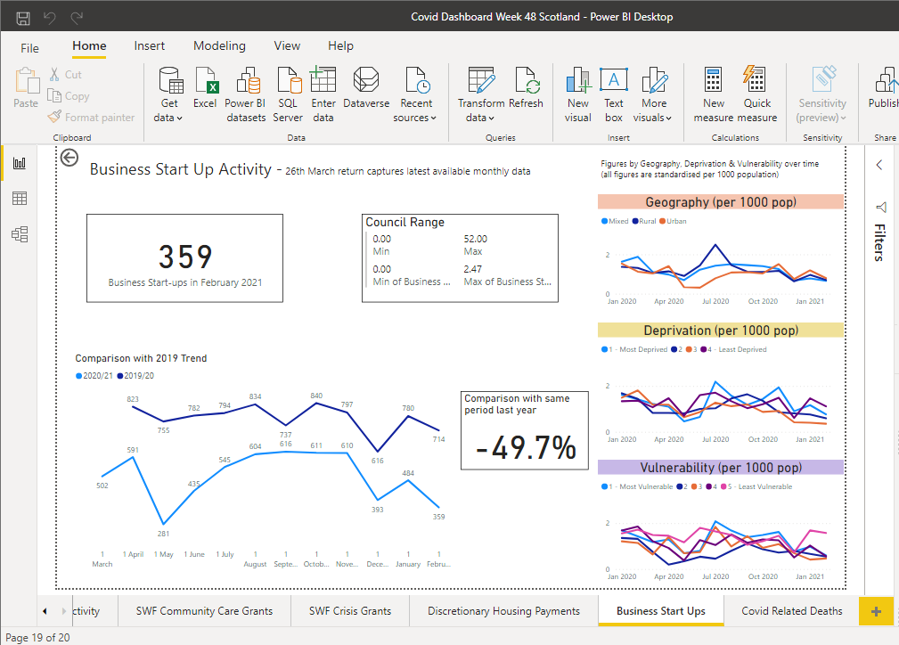

Covid-19 Dashboard
We broker additional resources for local government to support improvement
Notes:
-Final product - range of areas about LG’s response to the pandemic
-Power BI (vs shiny)
-many pages and datasets
-homelessness, shielding, child protection registrations, rent arrears, staff and pupil school absence, delayed discharges from hospitals, deaths, Scottish Welfare Fund statistics

Slide 5
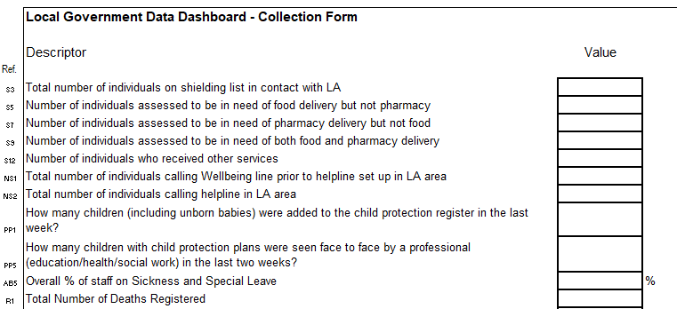







The Data
We help councils deliver against local and national priorities
Notes:
What started in March and April 2020: 22 indicators to be gathered from local authorities – 1 spreadsheet

Slide 6





The Data
We help councils deliver against local and national priorities
Notes:
-Even more from other sources – LGBF, NRS, Scottish Government, PHS, Housing Regulator, Google,
-more about new areas e.g. school attendance and absence, test and protect, vaccinations,
-Newly accessing some data sources - Scottish Welfare Fund stats, Discretionary housing payments,
-other indicators dropped out such as shielding

Slide 7
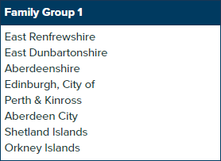
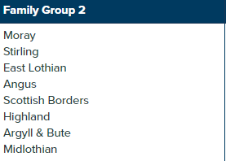
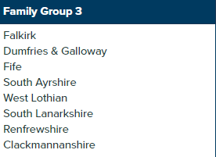
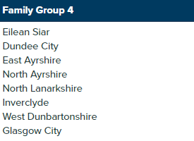

Analysis
We provide a wide range of practical improvement support
Notes:
-Really standardisation and aggregation
-aggregate this by family group (from LGBF), rurality, vulnerability
-Convert some to percentage, some per 1000, some per 10,000, 100,000 (per under 15s, 16-64s, 65+)

Slide 8
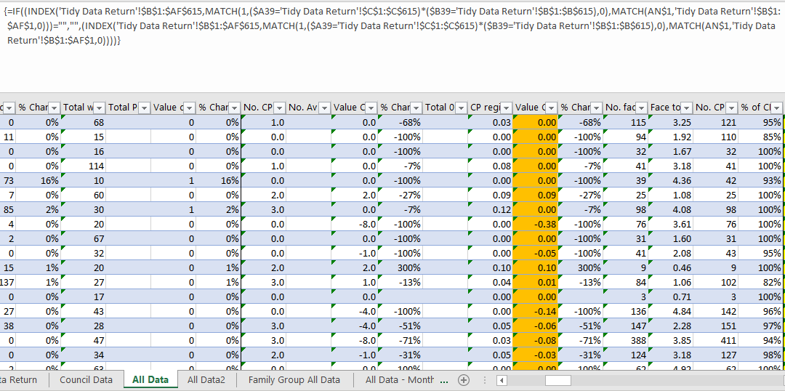
Analysis
We provide a wide range of practical improvement support
Notes:
-Excel sheet
-Copying and pasting sections, changing this huge formula, linking to new sheets
-Very slow

Slide 9


Our Saviours
We provide a wide range of practical improvement support

Slide 10



Quick note on Google Mobility Index
Filter and tidy data
Create family group and weekly averages etc.
We work closely with local government partners to better align policy, improvement and delivery
Notes:
-small case study/pilot
-This process vs Excel – maybe took a while to set up, but on a weekly basis can save hours
-Previously get all LAs in the world and filter etc.
-Access through the static url to read into R -> filter and tidy to select the right places, aggregate, save to csv

Slide 11


The Process
Step 0 – we still receive some data in Excel and save these in a folder.
Step 1 –and read into R – merge into daily, weekly, monthly datasets
Step 2 – standardising measures
Step 3 – creating family group, vulnerability index and rurality averages
Step 4 – write to Excel documents that are then read into Power BI
We help support and develop effective and informed local political leaders
Notes:
-800 lines of code, so brief summary
-A lot of the data is actually in one Excel sheet and R can loop through and read these one at a time
–28 different Excel sheets and files

Slide 12
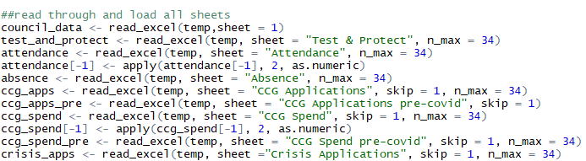
The Process
Step 0 – we still receive some data in Excel and save these in a folder.
Step 1 –and read into R – merge into daily, weekly, monthly datasets
Step 2 – standardising measures
Step 3 – creating family group, vulnerability index and rurality averages
Step 4 – write to Excel documents that are then read into Power BI
We help support and develop effective and informed local political leaders
Notes:
-Creating a temporary file linked from sharepoint and running through each sheet
-Still is quite manual – but data is (usually!) in same format, so doesn’t change
-Tidy into long format and group by time range

Slide 13
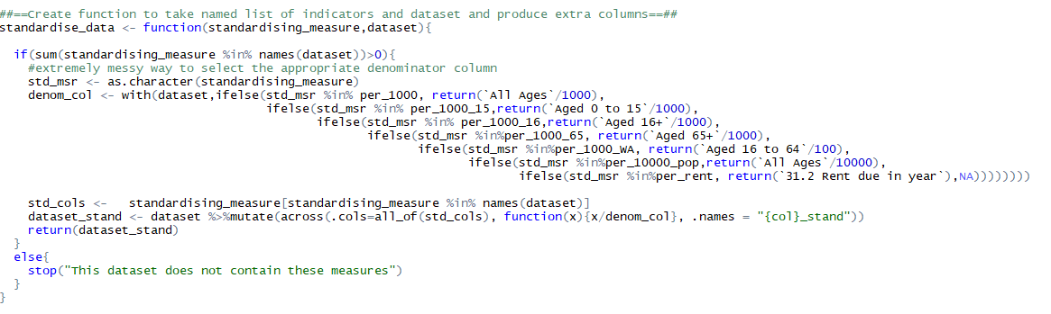
The Process
Step 0 – we still receive some data in Excel and save these in a folder.
Step 1 –and read into R – merge into daily, weekly, monthly datasets
Step 2 – standardising measures
Step 3 – creating family group, vulnerability index and rurality averages
Step 4 – write to Excel documents that are then read into Power BI
We help support and develop effective and informed local political leaders
Notes:
-Created a custom formula to do this
-Again a bit manual because we need to let R know which standardisation should apply to which column,

Slide 14
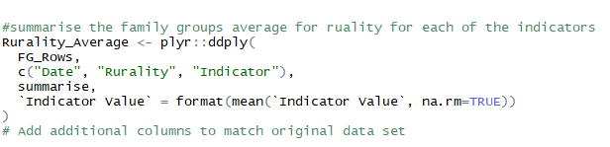
The Process
Step 0 – we still receive some data in Excel and save these in a folder.
Step 1 –and read into R – merge into daily, weekly, monthly datasets
Step 2 – standardising measures
Step 3 – creating family group, vulnerability index and rurality averages
Step 4 – write to Excel documents that are then read into Power BI
We help support and develop effective and informed local political leaders
Notes:
Using plyr ddply to group and average across data, grouping variable, and indicator

Slide 15

PLYR!?!
Haven’t you heard of dplyr/group_by/DT ??!?
We help support and develop effective and informed local political leaders

Slide 16

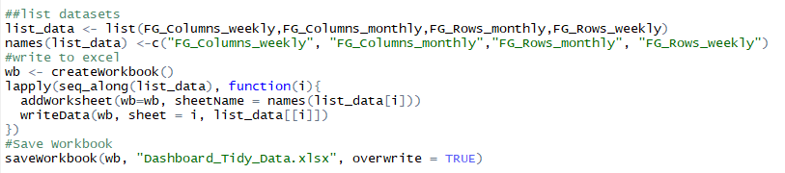
The Process
Step 0 – we still receive some data in Excel and save these in a folder.
Step 1 –and read into R – merge into daily, weekly, monthly datasets
Step 2 – standardising measures
Step 3 – creating family group, vulnerability index and rurality averages
Step 4 – write to Excel documents that are then read into Power BI
We help support and develop effective and informed local political leaders
Notes:
A bit of tidying then use openxlsx to write to Excel

Slide 17




Advantages
We make innovative use of data and intelligence to support decision making
Notes:
Time – took around 8 days to set up, but saves hours every week – we did this around week 40 and we’re into week 75 now
Reduce human error
Didn’t have to learn Dax

Slide 18

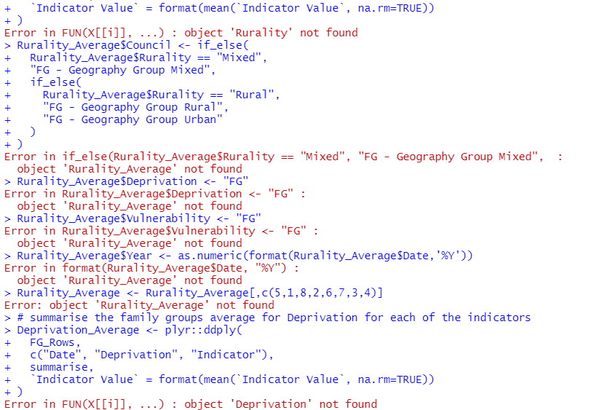
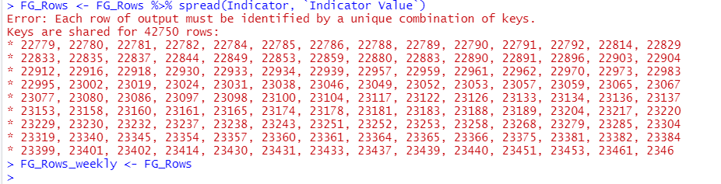
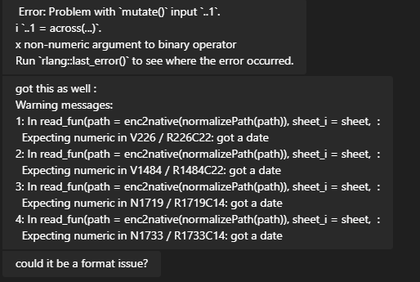

Some Stumbling Blocks – Error After Error
We are innovators for local government and help councils to identify and share good practice
Notes:
These are almost always to do with the data entered – solution (which we haven’t implemented) is to convert data types when they are read in: so often a comma is entered instead of a decimal point so R reads it as a character instead of float and everything breaks.
Only issue is it might not be clear where a catastrophic error has occurred, also limited R knowledge.

Slide 19

Thank you!
We facilitate the sharing of skills, capacity, knowledge and expertise

